Slide 1
ANL201 – Study Units
Time frame and Deliverables
Study Unit | Topic | Date (2022) | Quiz | Deadlines
1 | Business Performance Management Balanced Scorecard Strategy Map | 3rd Feb | Pre-Course Quiz 01* | 24th Jan – 4th Feb
2 | All about Data | 10th Feb | Pre-Class Quiz 01* | 7th Feb – 14th Feb
 |  |  | Tutor Marked Assignment | 16th Feb (by 2355 hrs)
3 | Theory/ Foundation to Visualization | 17th Feb | Pre-Class Quiz 02* - | 21st Feb – 28th Mar
4 | Basic Visualization | 24th Feb |  | -
5 | Advanced Visualization | 3rd Mar | Group Based Assignment | 2nd Mar (by 2355 hrs)
6 | Business Performance Dashboard | 10th Mar | End of Course Assessment | 17th Mar (by noon)
*All quizzes have a 12-NOON deadline. No extensions!

Slide 2
Learning Objectives of ANL201
By the end of this Course
Understand concepts of Business Performance, Measurement, Balanced Scorecard Model and Data Visualization
Compare stages of Data Visualization Process
Data Visualization Components
Design Principles of a Business Performance Dashboard
Appropriateness of Data Visualization techniques based on available data
Appropriates of Business Performance Measure against Business Strategy of Organization
Required Textbooks:
Yau, N,.(2013). Data Points: Visualization that Means Something
Murray, D. G. (2013). Tableau Your Data

Slide 3
Visualisation for Business ANL 201
Business Performance Dashboard Study Unit 6
January 2022

Slide 4
Business Performance Dashboard

Slide 5
Business Performance Dashboard
The big idea (1/2)
A business performance dashboard can be defined as a visual display of the most important information needed to achieve one or more objectives, consolidated and arranged on a single screen so that the information can be monitored at a glance
This allows management to identify business processes that are doing well and those that are having problems and requiring corrective action

Slide 6
Business Performance Dashboard
The big idea (2/2)
The business performance dashboard serves as a critical performance reporting function in the strategic performance management model
It acts like a magnifying glass to bring to focus an organisation’s attention on deficiencies that impede the achievement of the overall strategy
People → Mange people (movement, resourcing)
Process → Monitor critical business processes & activities
Product → Quantify Logistics, inventory, QA/QC
Profit → Track the meeting of organizational goals
Strategic Dashboard
Tactical Dashboard
Operational Dashboard

Slide 7
Business Performance Dashboard
The strategic dashboard
The strategic dashboard is used by senior executives and managers to monitor the execution of strategic objectives. These strategic objectives can be the results of using a balanced scorecard approach
The key features of the strategic dashboard are simplicity and high visual impact
An intuitive strategic dashboard is something that allows senior management to understand the company’s performance at a glance, and drill down to the details of any indicator or the underlying tactical dashboard

Slide 8
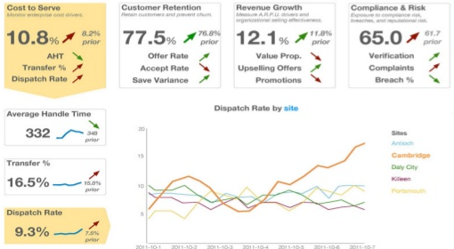
Strategic Dashboard
Source: http://image.slidesharecdn.com/artandscienceofdashboarddesign-140313160137-phpapp01/95/art-and-science-of-dashboard-design-24-638.jpg?cb=1394726642
Simple
Visual
Intuitive

Slide 9
Business Performance Dashboard
The tactical dashboard
A tactical dashboard is used by managers and analysts to track the progress of departmental processes and projects against budget plans, forecasts or previous periods achievements

Slide 10
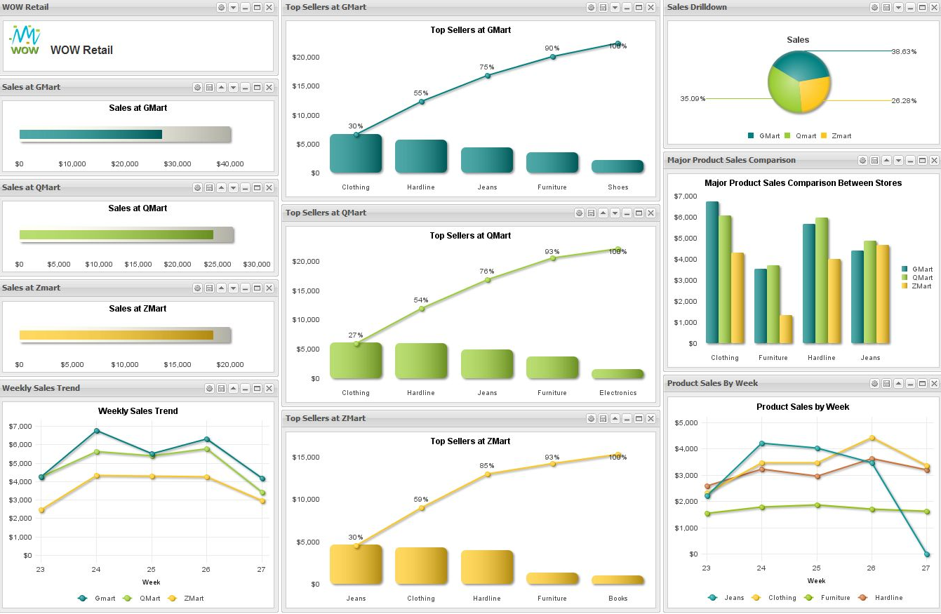
Tactical Dashboard
Multi-Dimensional
Slice-and-dice
Source: http://www.visualmining.com/wp-content/uploads/2012/10/Retail-Example-Dashboard.jpg

Slide 11
Business Performance Dashboard
The operational dashboard
The operational dashboard is used by operational staff and their supervisors to monitor operational processes

Slide 12
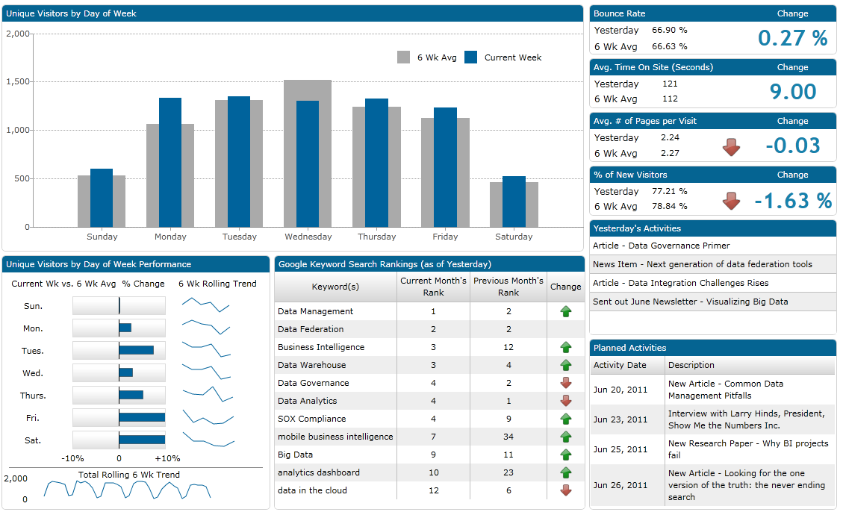
Operational Dashboard
Specific to the task
Source: http://www.dashboardinsight.com/CMS/bcd462ac-24a3-44af-ad1d-2cadc951ae0d/website-operational-dashboard.png
Notes:
The Operational Dashboard is usually very specific to a particular operation or process.
The image is a website operational dashboard that shows the performance metrics and key performance indicators required to operate a website

Slide 13
Business Performance Dashboard
Benefits of the business performance dashboard (1/3)
Mission, Vision
Communicate strategy — Business performance dashboards facilitate the translation of corporate strategy into measures with their corresponding targets
Increase insight — Business performance dashboards empower the management team with greater insights into the business performance in a timely manner
Increase motivation — With the measures and the corresponding targets displayed in business performance dashboards, the motivation to excel in the measured areas is increased
Proactive rather than reactive
(Can be a demotivator too – be careful)

Slide 14
Business Performance Dashboard
Benefits of the business performance dashboard (2/3)
Increase coordination — Objectivity, openness and transparency in business performance dashboards help promote effective coordination, and encourage different departments to work more closely
Consistent view of business — Business performance dashboards consolidate and integrate business performance information using a common platform, definition, measures, and rules
Collaboration
Standardisation; single view on information

Slide 15
Business Performance Dashboard
Benefits of the business performance dashboard (3/3)
Simplification of information systems
Reduce cost and redundancy — Standardising information and reporting based on business performance dashboards can eliminate the duplication of reports
User sufficiency and empowerment — Business performance dashboards allow users to be self-sufficient in creating, organising, and presenting information on business performance
Resolve business issues quicker

Slide 16
Business Performance Dashboard
Attributes of the business performance dashboard
Display of selected measures and their corresponding targets that track business performance
Graphics that facilitate visualisation of past trends or magnitude of differences
The use of traffic light colours (green, ember, and red) to demarcate regions of desirability for a measure
Ask the fundamental questions:
Who (is my audience)?
What (is my objective – information sharing or KPI or …)?
Where (will I need to focus on – visuals, data, data collection)?
When (was this data collected, when do I intend for it to be actioned, is it still relevant)?
Why (is a dashboard necessary, can I just use pen and paper)?
How (will I explain what I created)?

Slide 17
Dashboard Design Principles

Slide 18


Dashboard Design Principles
Dashboard design principles
Keep it simple
Don’t display everything
Keep to a single page
Avoid fancy formatting
Use layout and placement
Format numbers effectively
Use titles and labels effectively
Ask the fundamental questions:
Who (is my audience)?
What (is my objective – information sharing or KPI or …)?
Where (will I need to focus on – visuals, data, data collection)?
When (was this data collected, when do I intend for it to be actioned, is it still relevant)?
Why (is a dashboard necessary, can I just use pen and paper)?
How (will I explain what I created)?
Keep it Super Simple

Slide 19

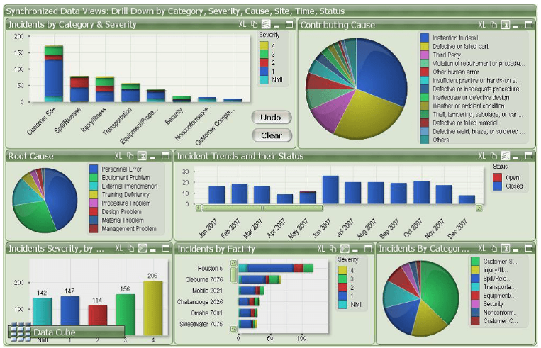
Discussion
What is wrong with this dashboard?
Source: https://www.geckoboard.com/blog/5-terrible-dashboard-designs-and-how-to-fix-them/#.WD1IHYVOKuU
Notes:
Overuse of color - The number of color used in this dashboard is distracting and makes it difficult to understand This creates a huge cognitive barrier for the brain when trying to process the data quickly.
Pie charts - The large data set (“Contributing Cause”) makes the pie chart impossible to determine the percentage of each item

Slide 20
Discussion
What is wrong with this dashboard?
Overuse of color - The number of color used in this dashboard is distracting and makes it difficult to understand This creates a huge cognitive barrier for the brain when trying to process the data quickly.
Pie charts - The large data set (“Contributing Cause”) makes the pie chart impossible to determine the percentage of each item.
Source: https://www.geckoboard.com/blog/5-terrible-dashboard-designs-and-how-to-fix-them/#.WD1IHYVOKuU
Notes:
Overuse of color - The number of color used in this dashboard is distracting and makes it difficult to understand This creates a huge cognitive barrier for the brain when trying to process the data quickly.
Pie charts - The large data set (“Contributing Cause”) makes the pie chart impossible to determine the percentage of each item

Slide 21
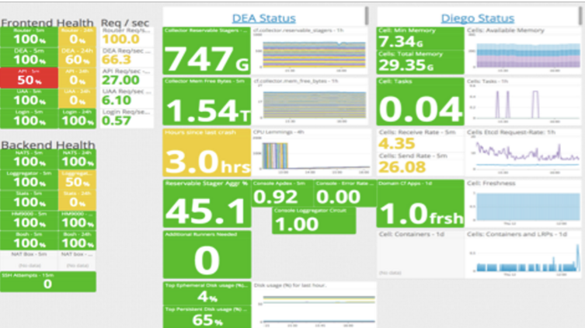
Discussion
What is wrong with this dashboard?
Source: https://www.geckoboard.com/blog/5-terrible-dashboard-designs-and-how-to-fix-them/#.WD1IHYVOKuU
Notes:
Don’t display everything - this dashboard is too cluttered and poorly structured, making it difficult to navigate.
Variation in font sizes - there doesn’t appear to be any hierarchy to the extreme range in font sizes.
Metrics hard to interpret - the window size for each metric varies arbitrarily, making it more difficult to process. Are some numbers more important than others

Slide 22
Discussion
What is wrong with this dashboard?
Don’t display everything - this dashboard is too cluttered and poorly structured, making it difficult to navigate.
Variation in font sizes - there doesn’t appear to be any hierarchy to the extreme range in font sizes.
Metrics hard to interpret - the window size for each metric varies arbitrarily, making it more difficult to process. Are some numbers more important than others?
Source: https://www.geckoboard.com/blog/5-terrible-dashboard-designs-and-how-to-fix-them/#.WD1IHYVOKuU
Notes:
Don’t display everything - this dashboard is too cluttered and poorly structured, making it difficult to navigate.
Variation in font sizes - there doesn’t appear to be any hierarchy to the extreme range in font sizes.
Metrics hard to interpret - the window size for each metric varies arbitrarily, making it more difficult to process. Are some numbers more important than others

Slide 23
Creating Business Performance Dashboards
(15 mins)

Slide 24
Creating Business Performance Dashboards
Creating business performance dashboards in Tableau
Position objects in the dashboard workspace
Use action to create advanced dashboard navigation
https://public.tableau.com/en-us/s/blog/2015/06/rough-guide-dashboard-actions
Notes:
Before we position objects in the Dashboard Workspace, we need to define the sizing of the entire Dashboard and the individual objects included in the Dashboard workspace.
Once the size has been defined, we are ready to add individual Worksheet objects into the Dashboard. There are two ways to add objects into the Dashboard Workspace. We can either drag the selected object into the “Drop sheet here” area or double click the Worksheet objects on the top-left hand corner.
To control the placement of an individual object more precisely, drag the object into the View.
Subsequently, we need to add a title to the Dashboard by selecting the “Show Title” option on the bottom left of the Dashboard Shelves.
We can build Actions that filter and highlight the main Dashboard. Actions facilitate insight discovery by altering the context of the Dashboard based on selections made by the Dashboard viewers. Highlighting helps Dashboard viewers to see related information more easily.
To create a Filter Action, we need to activate the object we want to filter, select the drop down arrow to expose the filter menu, pick the “use as filter” menu option, and edit the Filter Action.
To edit a filter action, we need to access the dashboard’s menu option, then select the actions menu to expose the actions dialogue box.
Users can generate the Highlighting function from Legends by activating the Highlighting tool that appears when we point at the Legend.

Slide 25
Tableau (Class Activity)

Slide 26
Tableau (Class Activity)
Follow your instructor to create a storyboard using dashboards for Amazing Mart.
Amazing Mart’s Sales Manager would like to have a dashboard that tracks the sales and profits of the products they sell.
The collected data is stored in 2 entities, List of Orders and Order Breakdown.
List of Orders contains information about the customer, such as customer name, the segment they are in, order date, shipping date, and mode.
Order Breakdown contains information about the product they purchased, the sales price and the profit that was made from the sales.
Notes:
Using the AmazingMart data set, create dashboards and storyboard
You can get the students to discuss on what would be good dashboard design elements, and need not necessary follow the solutions as indicated in the slides.

Slide 27
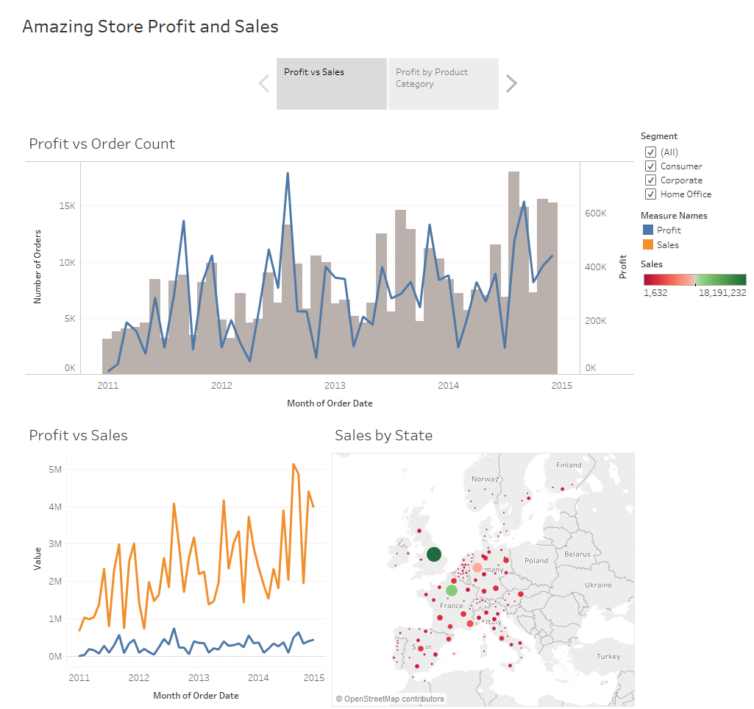
Tableau (Class Activity)
Notes:
Guide the students through to create the charts
Set the Order Date to be continuous
Profit vs Order Count – Set Month(Order Date) to column, count of records and sum(profit) as rows. Create filter for segment. Rename the axis accordingly.
Profit vs Sales – Set Month(Order Date) to column, sum(sales) and sum(profit) as rows.
Sales by States – Set longitude as column and latitude as rows. Set sum(sales) as colour and size, Edit the colour to red-green. Set state for details.
Create a dashboard as displayed. Set the segment filter to be applied to all sheet in this dashboard.

Slide 28
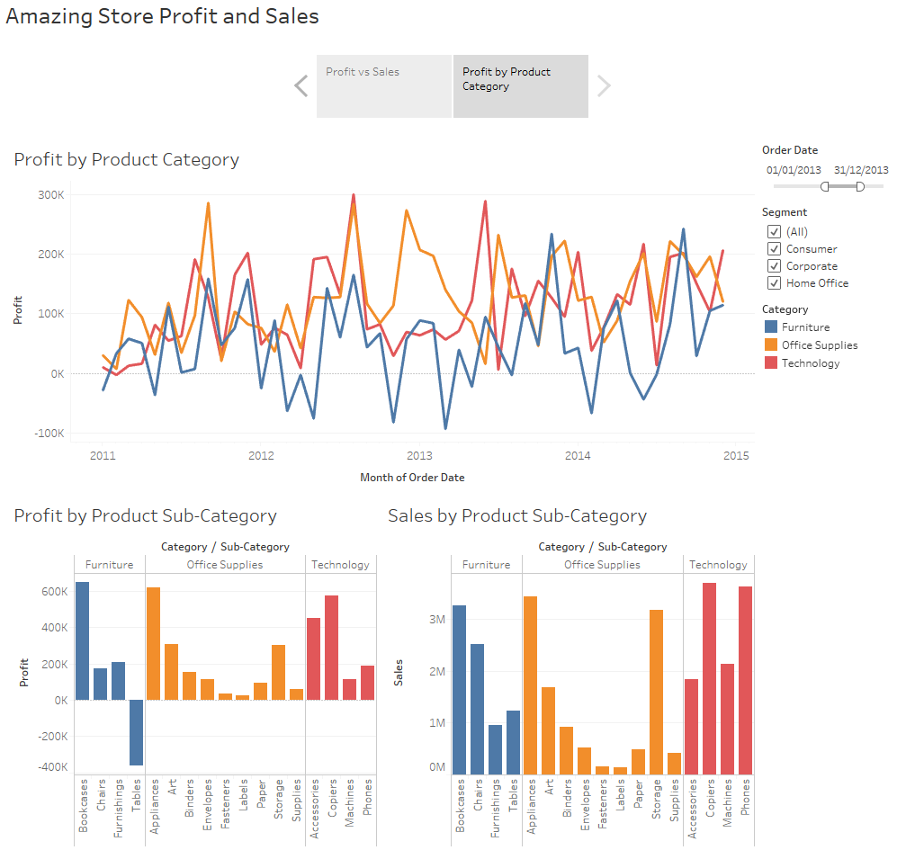
Tableau (Class Activity)
Notes:
Profit by Product Category – Set Month(Order Date) to column and sum(profit) as rows. Create filter for segment.
Profit vs Product Sub-Category – Set Category and Sub-Category to column and sum(profit) as rows. Set product category as the colour. Create filter for Order Date
Sales vs Product Sub-Category – Set Category and Sub-Category to column and sum(sales) as rows. Set product category as the colour.
Create a dashboard as displayed. Set the segment filter to be applied to all sheet in this dashboard. Set the Order Date filter to be applied Profit vs Product Sub-Category and Sales vs Product Sub-Category. Create a storyboard and put the 2 dashboards into the storyboard. Add the storyboard title and the title for the pages.

Slide 29
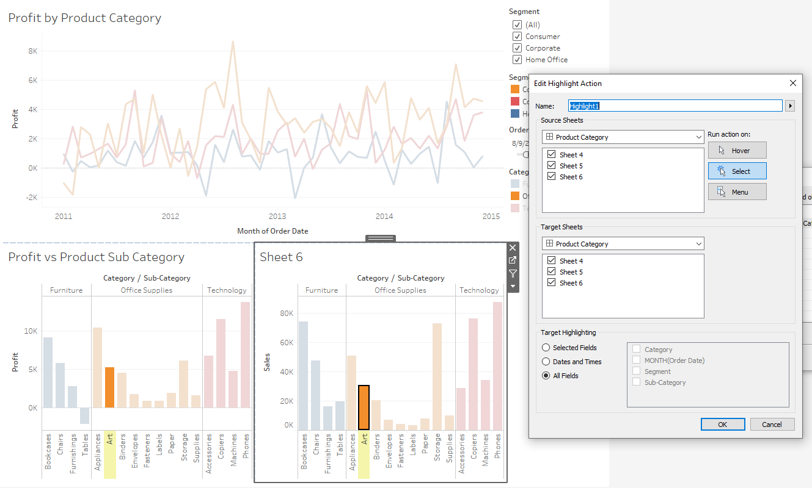
Tableau (Class Activity)
Notes:
Illustrate how to create an Action for highlighting specific data fields. If time permits, you can cover other Actions such as Go to URL as well.

Slide 30
Course Homepage | https://canvas.suss.edu.sg/courses/31564
Study Guide | https://ibookstore.suss.edu.sg/
Tableau Desktop | https://www.tableau.com/products/trial
Tableau Tutorials | https://www.tableau.com/learn/get-started/creator
Academic Calendar | https://www.suss.edu.sg/docs/default-source/contentdoc/oas/pt-2021acadcalendar.pdf

Slide 31
Tableau Desktop System Requirements
Windows
Windows 7 or newer (64 bit)
Intel Pentium 4 or AMD Opteron processor or faster
2 GB memory
1.5 GB minimum free disk space
Mac
iMac/MacBook computers 2009 or newer
macOS High Sierra 10.13 and macOS Mojave 10.14
1.5 GB minimum free disk space
Notes:
Get licenses for students at https://www.tableau.com/academic/teaching/course-licenses

Slide 32
Tableau Prep Builder System Requirements
Windows
Windows 7 or newer (64 bit)
Intel Core i3 or AMD Ryzen 3 Pro or faster
4 GB memory
2 GB minimum free disk space
Mac
macOS High Sierra 10.13 and macOS Mojave 10.14
Intel Core i3 or faster
4 GB memory
2 GB minimum free disk space

